Slide 1
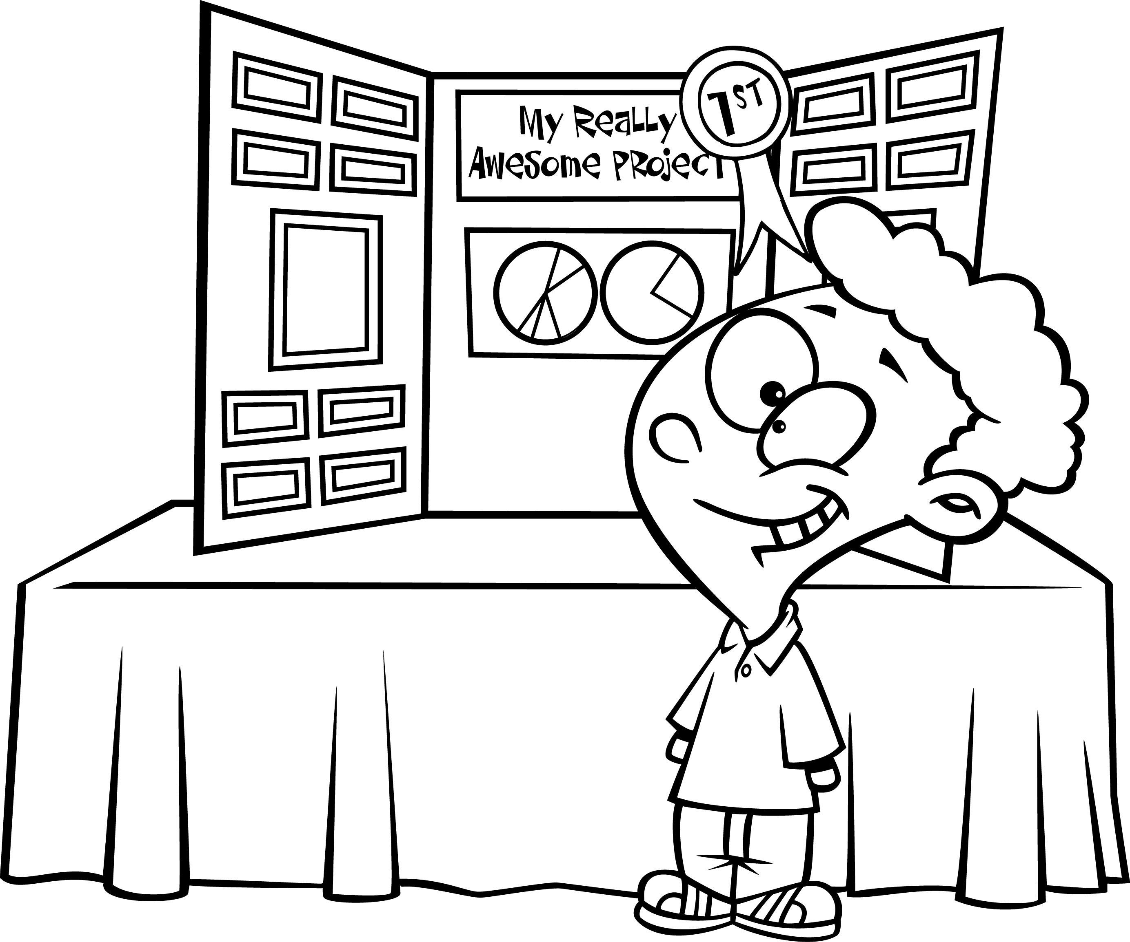
Name: _____________________________________________ Period: ________________
SCIENCE FAIR DATES
2017 - 2018
8th Grade CSMS Science Fair: November 29- December 1, 2017
Tri-state Science & Engineering Fair at USI: March 8th and 9th
Due Dates | CSMS Science Fair – November 29 – December 1, 2017
9/1/2017 | Science Fair Project Selection Form Due (topic, variables and areas for background research) due September 1.
9/15/2017 | Entry Form due Friday, September 15.
9/22/2017 | Experimental design section of the paper needs to be typed (Hypothesis will be added after Introduction is completed) due Friday, September 22.
10/06/2017 | Introduction & Works Cited (typed) due October 6.
10/27/2017 | Add Hypothesis to Experimental Design. Begin Experimentation - take photos; Observations & Results; Complete Title Page, set up Table of Contents & remaining pages due October 27
11/10/2017 | Complete Results, Conclusions, Abstract & Acknowledgements. Complete Science Fair Report due November 10.
11/27/2017 | Display Board due November 27

